Slide 1
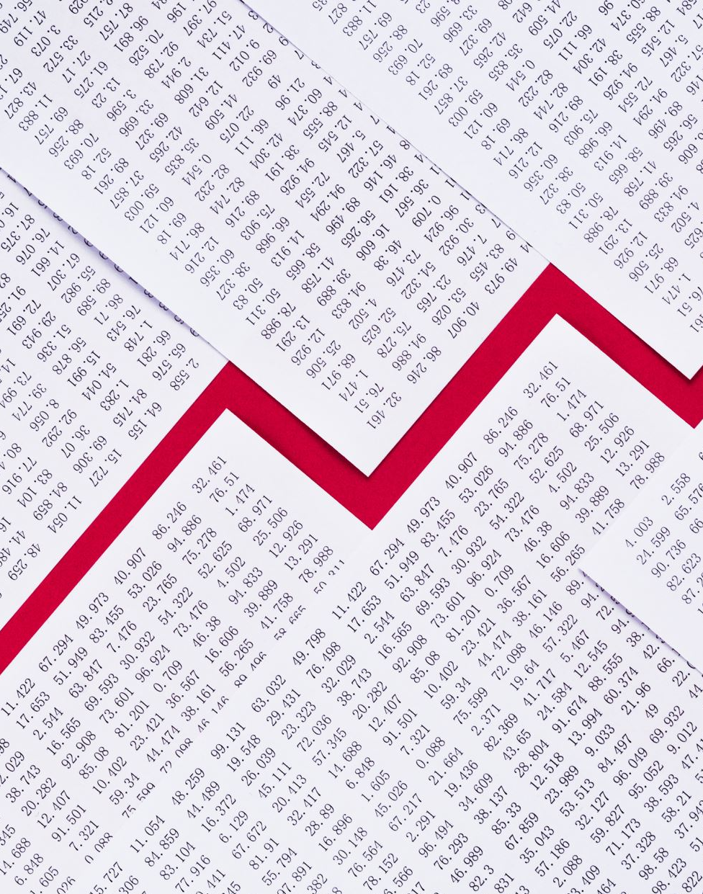
Black Friday Retail Sale Prediction
Group Members:
Jesee Avanakshi
Srikar Badugu
Prashansa Evangeline
Paavamani Manchala

Slide 2

Introduction
Retail companies often use historical sales data to predict future sales and plan their inventory and staffing accordingly. Accurate sales predictions can help retailers optimize their operations, reduce waste, and increase profits. However, predicting sales accurately can be challenging due to various factors such as changing customer preferences, market trends, and seasonality.

Slide 3

Motivation /Social Impact
The motivation behind this project is to help businesses improve their growth by using data analysis to understand customer behaviour when shopping online. With the increasing popularity of digital shopping and the pandemic, it is crucial for businesses to have a strong online presence and understand how to effectively offer discounts on various products to attract customers. By using regression models such as linear regression, Decision tree Regressor, and Random Forest Regressor, we can gain insights into customer behaviour and offer targeted discounts that increase sales.

Slide 4

Creativity
The project's creativity lies in the use of machine learning techniques to analyse customer data and predict shopping behaviour. The use of regression models such as linear regression, Decision tree Regressor, and Random Forest Regressor can help identify trends in customer behaviour and offer targeted discounts that increase sales. Additionally, by focusing on online sales, the project takes into account the changing retail landscape and the ongoing pandemic's impact on consumer behaviour. By offering data-driven insights into customer behaviour and effective discount strategies, the project can help businesses improve their growth and better serve their customers.

Slide 5
Contribution to Community:
Retail sales prediction can help the social community in several ways, some of which include:
Better resource allocation: With accurate sales predictions, retailers can allocate resources such as inventory, personnel, and marketing efforts more effectively, leading to better overall business performance and increased customer satisfaction.
Improved economic growth: Retail sales make up a significant portion of a country's economy, and accurate sales predictions can help to improve economic growth by allowing businesses to make informed decisions about investment and expansion.
Job creation: Accurate sales predictions can help retailers to make informed decisions about staffing levels, leading to job creation and improved employment opportunities in the community.
Increased tax revenue: Improved retail sales can lead to increased tax revenue for local and national governments, which can then be used to support social services and community initiatives.
Better planning for events and promotions: Retailers can use sales predictions to better plan for events and promotions, ensuring that they have adequate supplies and staffing in place to meet demand.

Slide 6
Steps we follow
Identify question/task
Collect data
Exploratory data analysis (EDA)
Feature and model selection
Train model
Evaluate and communicate results Deploy working system
Clean and preprocess data

Slide 7
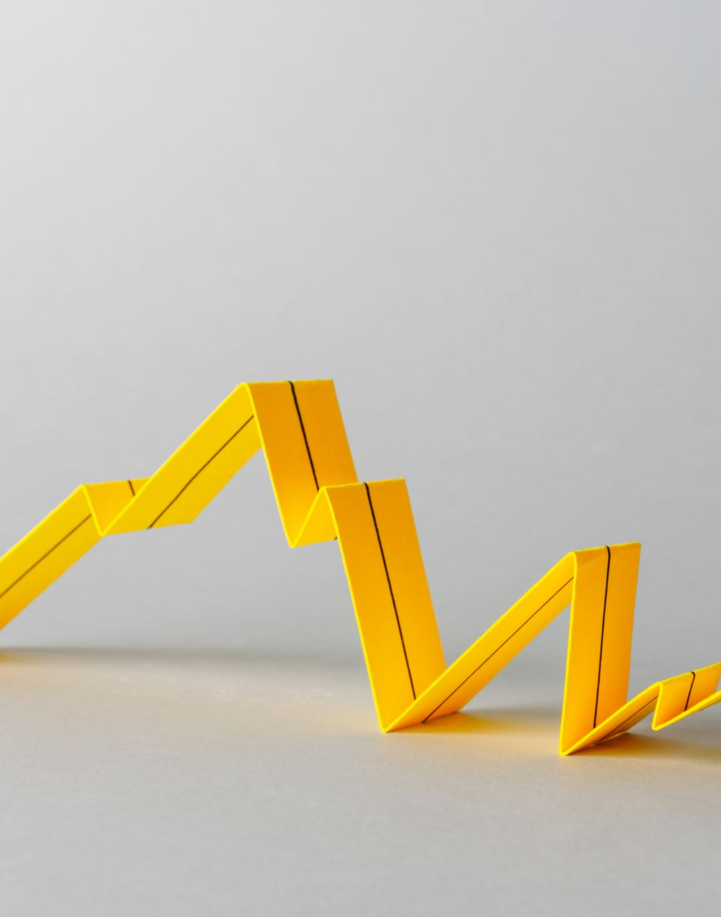
Identify Question/Task
Build a model that tries to analyse and predict based on information in retail dataset. We have used linear regression, Decision Tree Regressor, Random Forest Regressor, and XGBoost Regression and compared their performance.

Slide 8
Collect data
Source of dataset : Kaggle.
The data set consists of 550068 records of data and we have 12 columns like User ID, Age, purchase, etc.

Slide 9
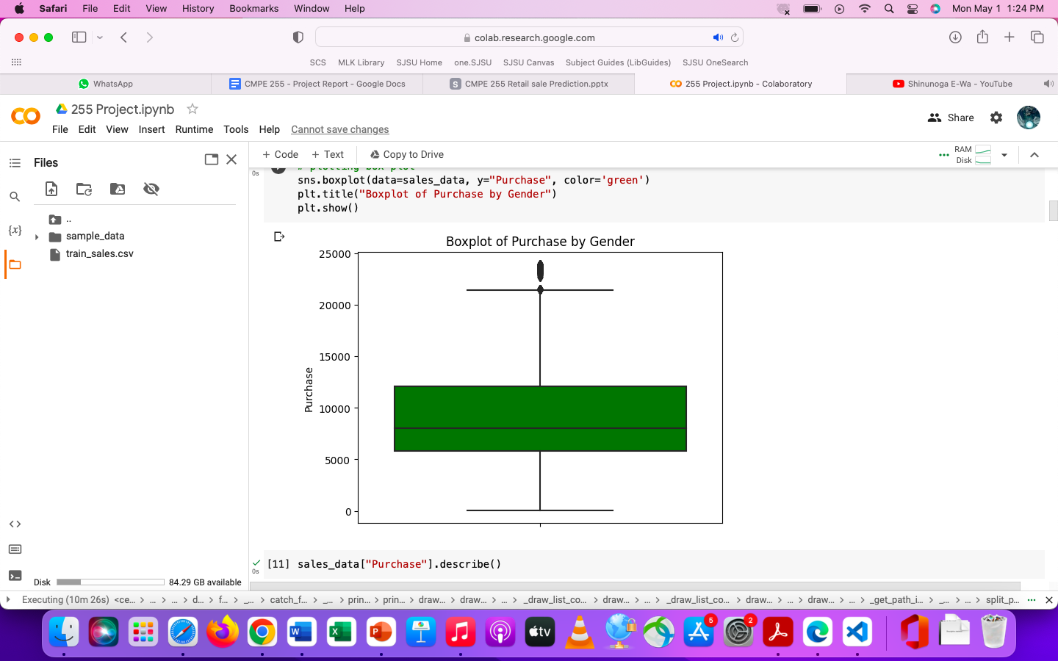
EDA Target Variable Purchase
Box plot

Slide 10
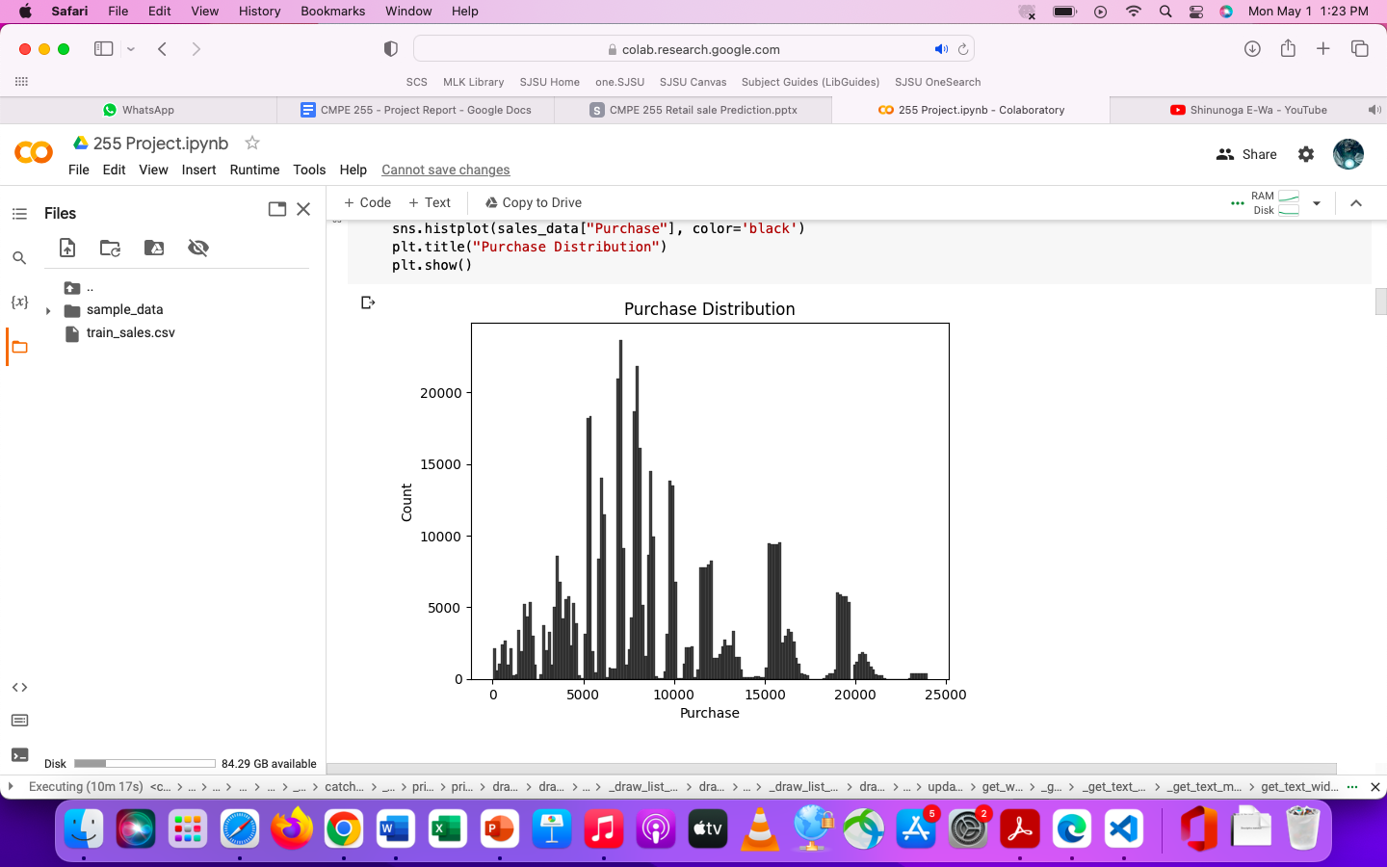
EDA Target Variable Purchase
Dist plot

Slide 11
Skew of purchase : 0.626053978164082
Kurotosis of purchase :-0.33735543297038584
The purchase is right skewed and we can observe multiple peaks in the distribution we can do a log transformation for the purchase.

Slide 12
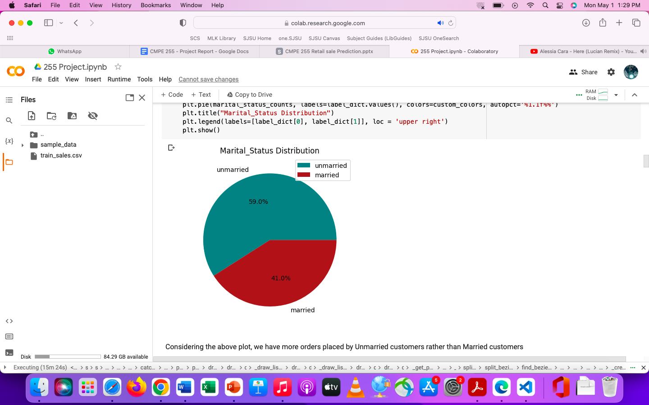
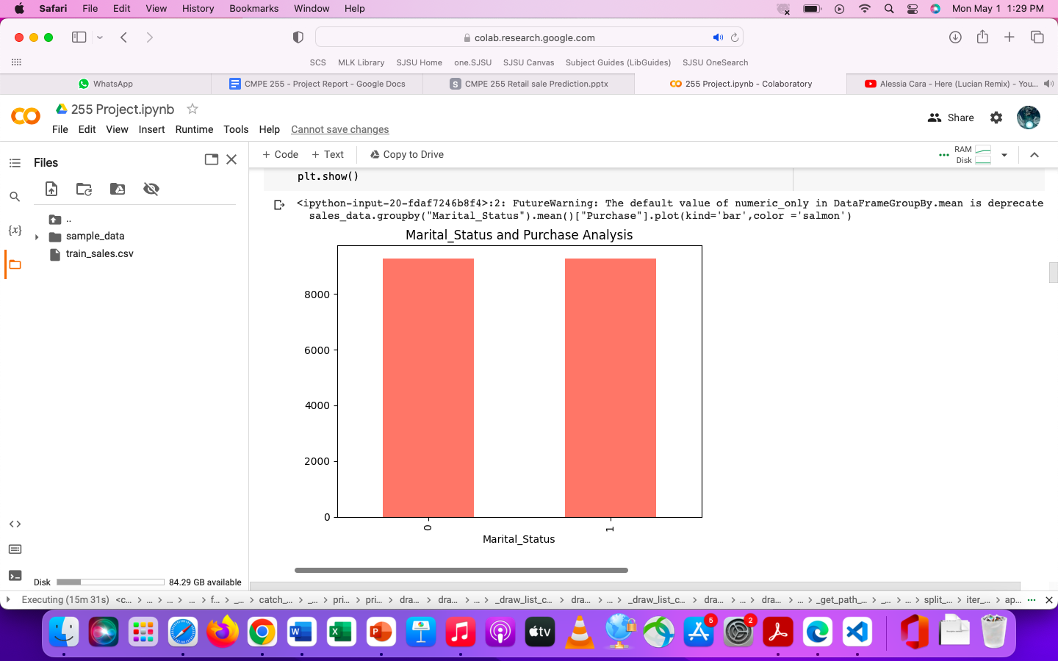
Plots
This is interesting though unmarried people spend more on purchasing, the average purchase amount of married and unmarried people are the same.
Notes:
This is interesting though unmarried people spend more on purchasing, the average purchase amount of married and unmarried people are the same.

Slide 13
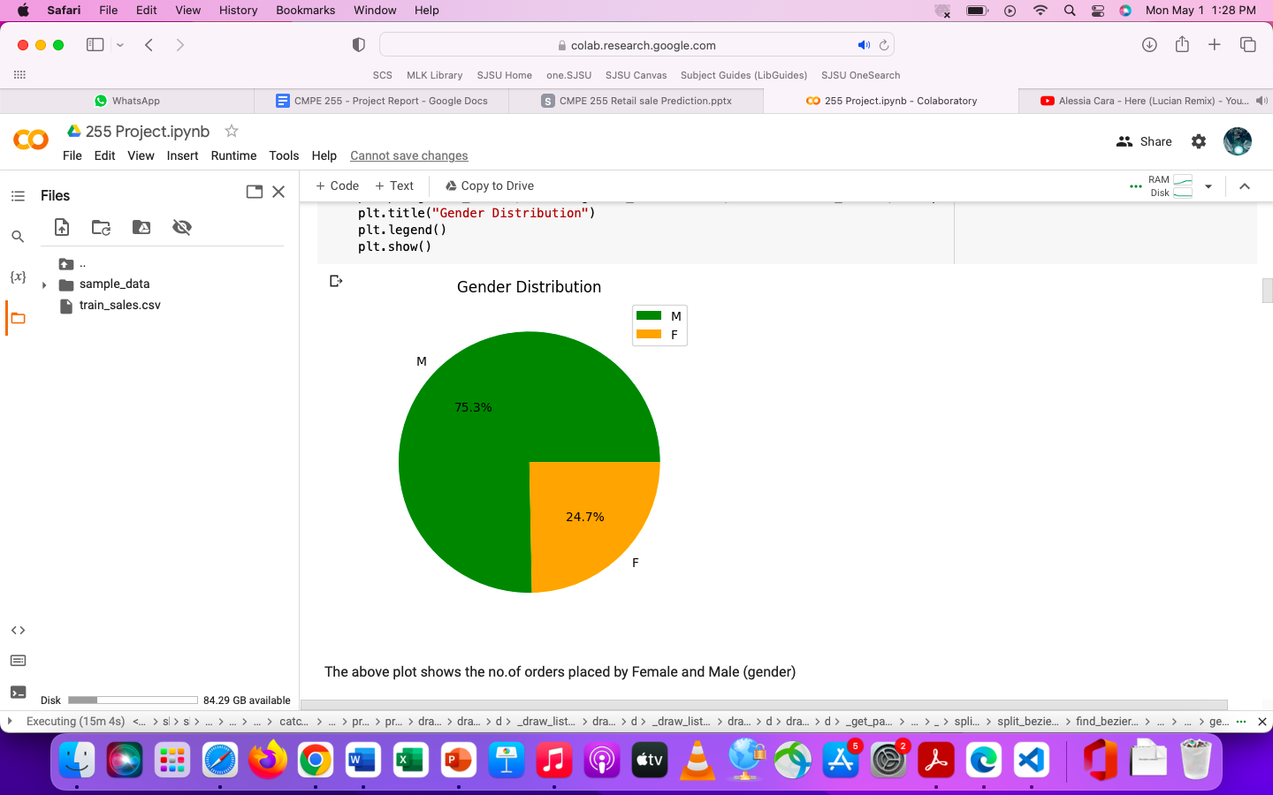
Plots
The above plot gives the distribution between male and female customers
Notes:
This is interesting though unmarried people spend more on purchasing, the average purchase amount of married and unmarried people are the same.

Slide 14
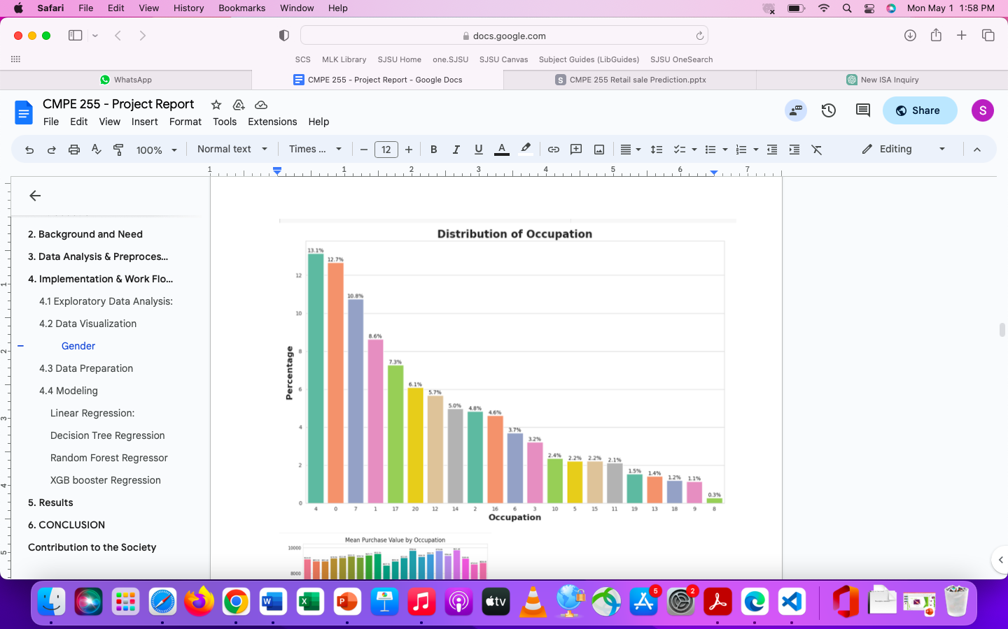
Occupation
Although there are some occupations which have higher representations, it seems that the amount each user spends on average is more or less the same for all occupations.
Notes:
Although there are some occupations which have higher representations, it seems that the amount each user spends on average is more or less the same for all occupations. Of course, in the end, occupations with the highest representations will have the highest amounts of purchases.

Slide 15
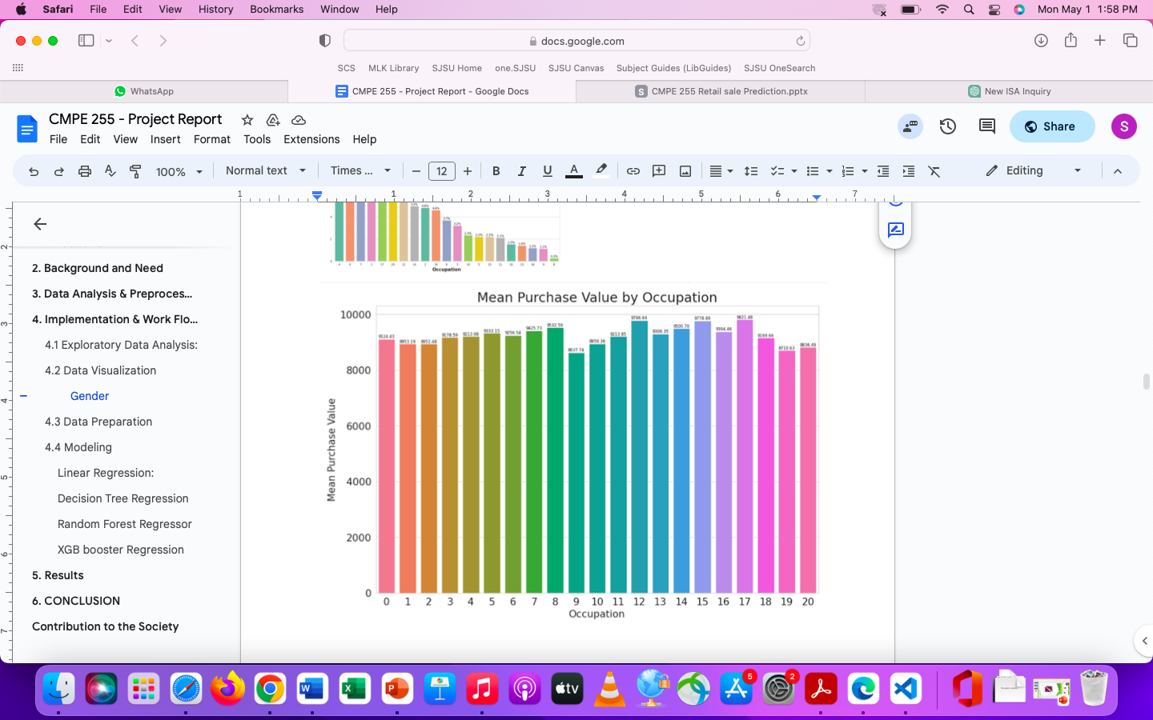
Occupation
Of course, in the end, occupations with the highest representations will have the highest amounts of purchases.
Notes:
Although there are some occupations which have higher representations, it seems that the amount each user spends on average is more or less the same for all occupations. Of course, in the end, occupations with the highest representations will have the highest amounts of purchases.

Slide 16
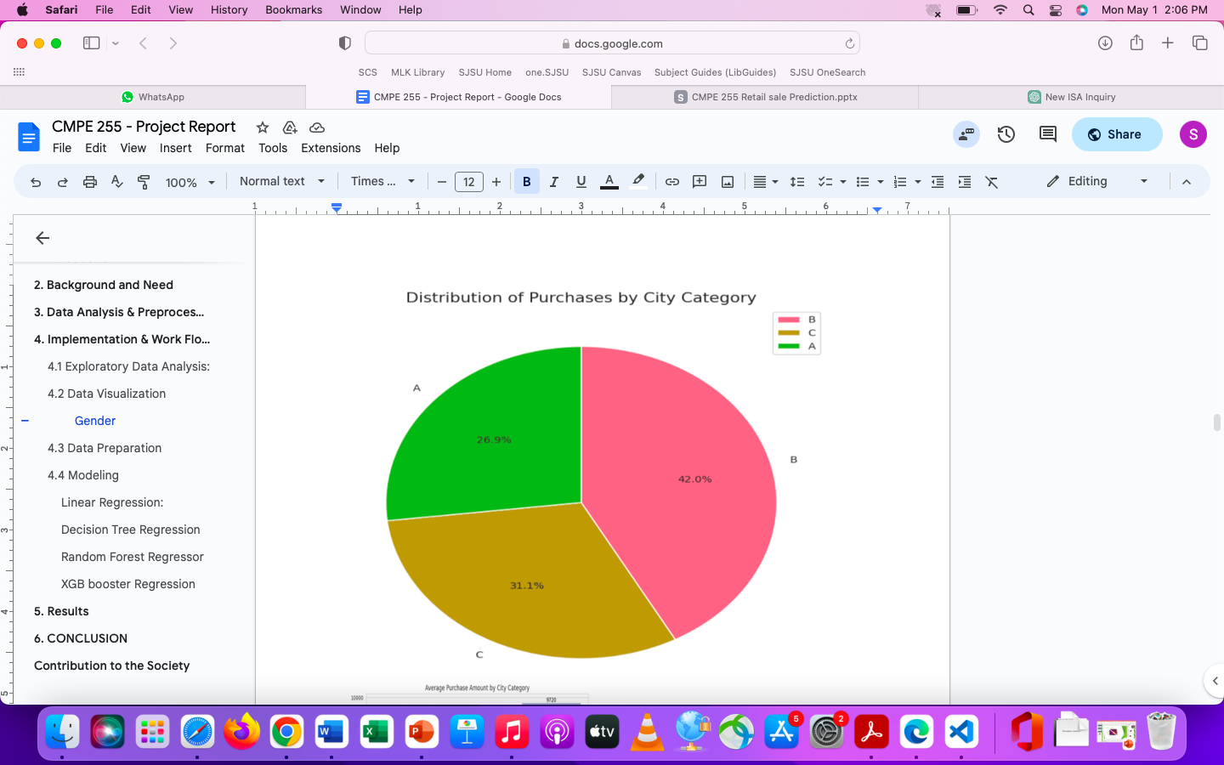
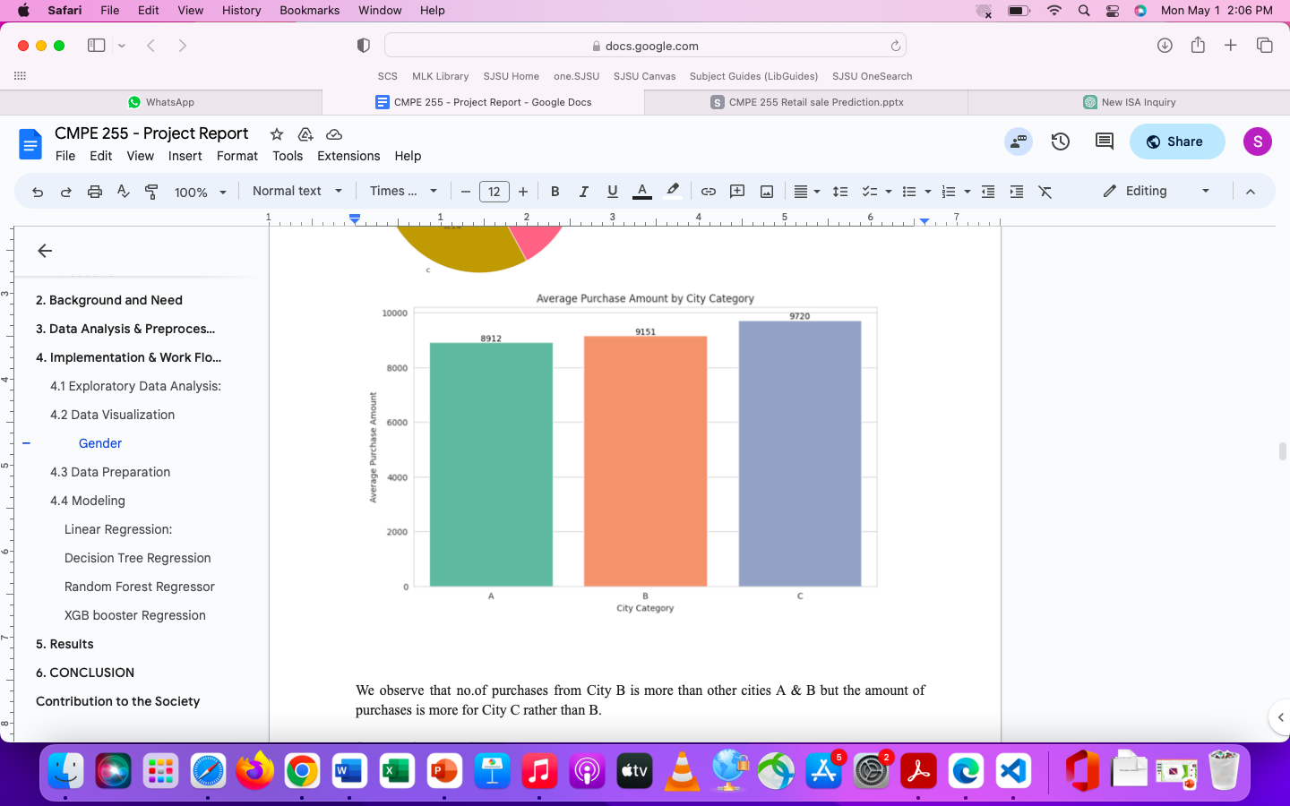
City_Category
Notes:
It is observed that city category B has made the most number of purchases. However, the city whose buyers spend the most is city type ‘C’.

Slide 17
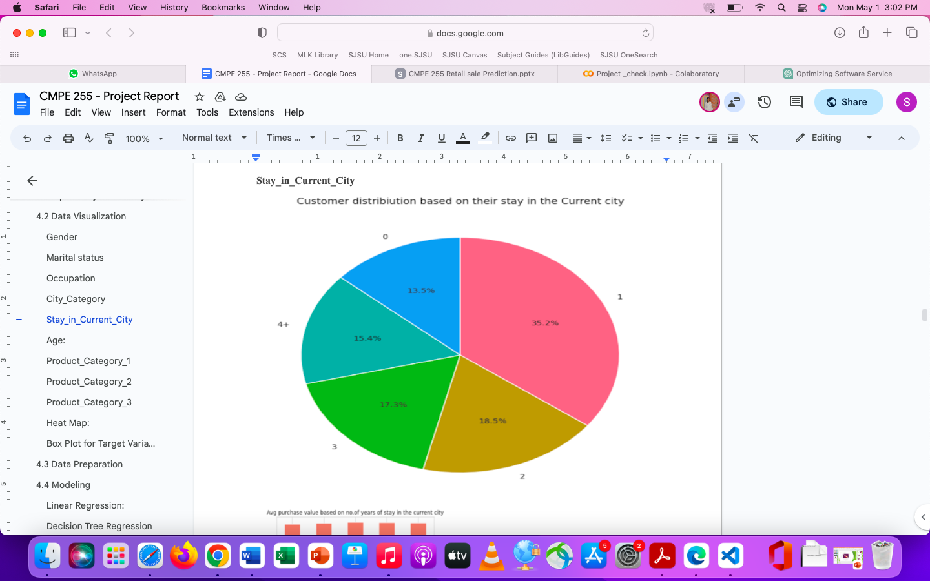
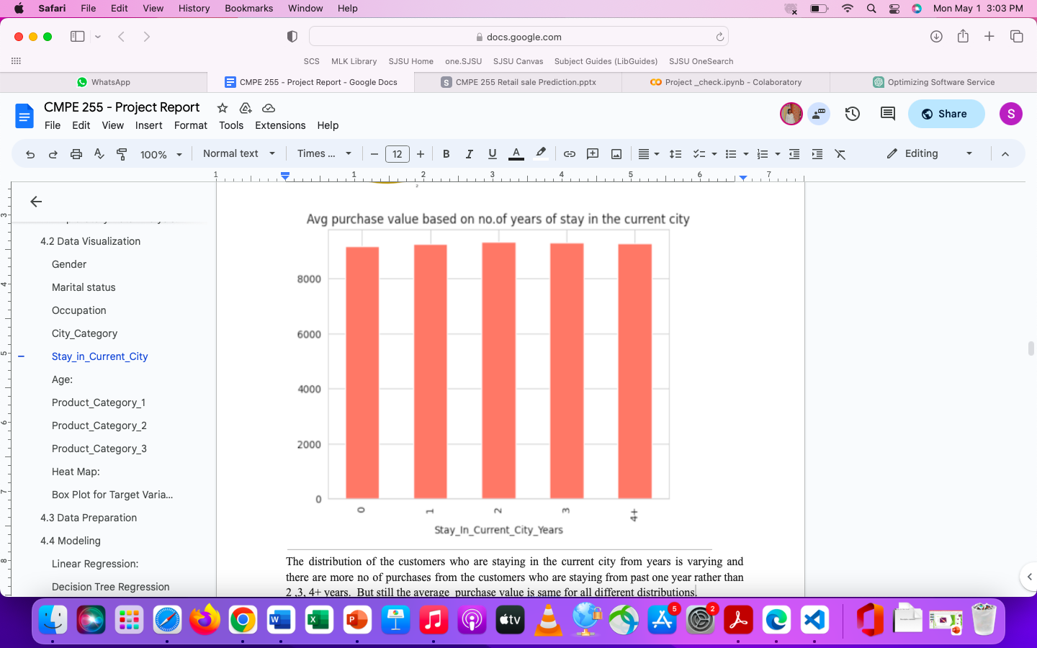
Stay_In_Current_City_Years
Notes:
It looks like the longest someone is living in that city the less prone they are to buy new things. Hence, if someone is new in town and needs a great number of new things for their house that they’ll take advantage of the low prices in Black Friday to purchase all the things needed. We see the same pattern seen before which show that on average people tend to spend the same amount on purchases regardeless of their group. People who are new in city are responsible for the higher number of purchase, however looking at it individually they tend to spend the same amount independently of how many years the have lived in their current city.

Slide 18
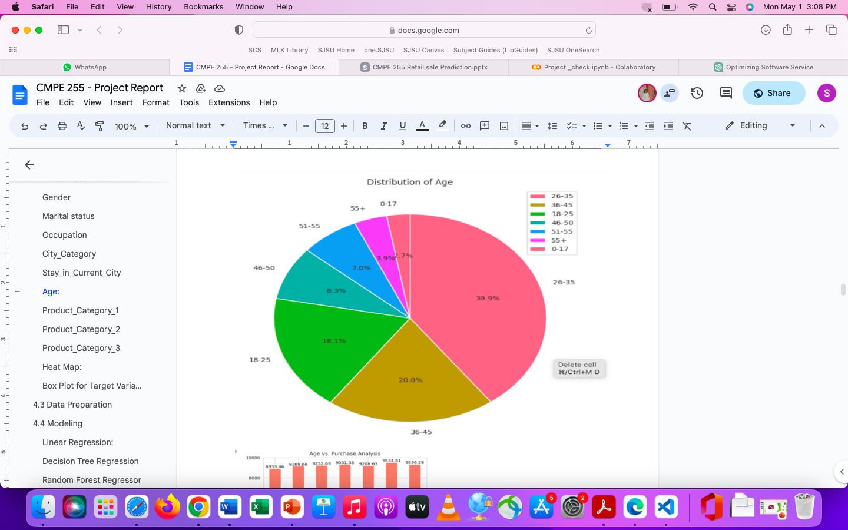
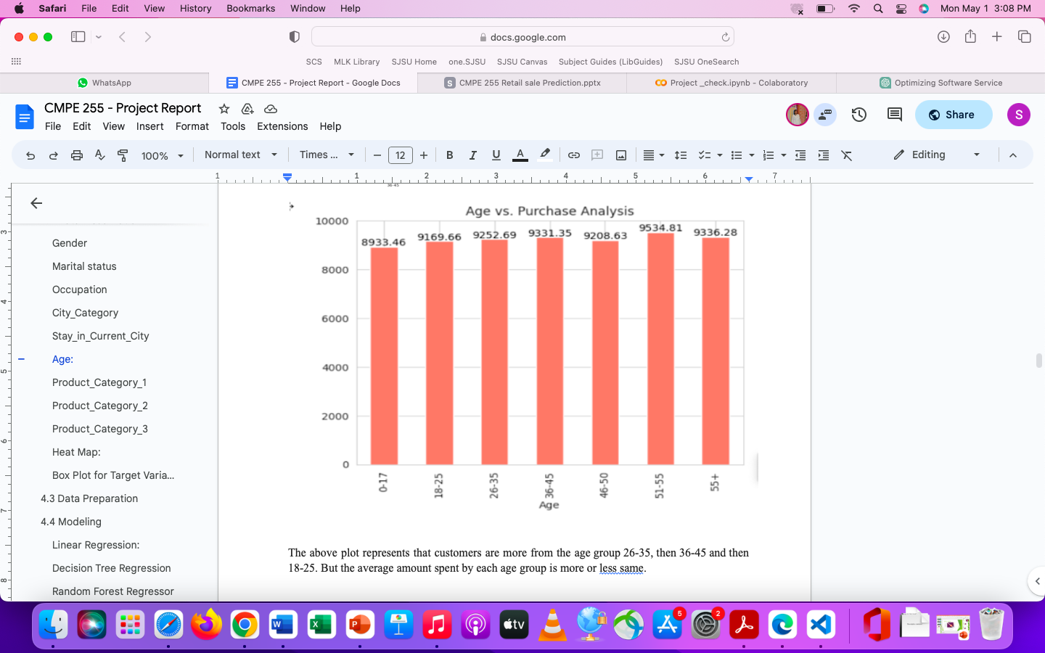
Age

Slide 19
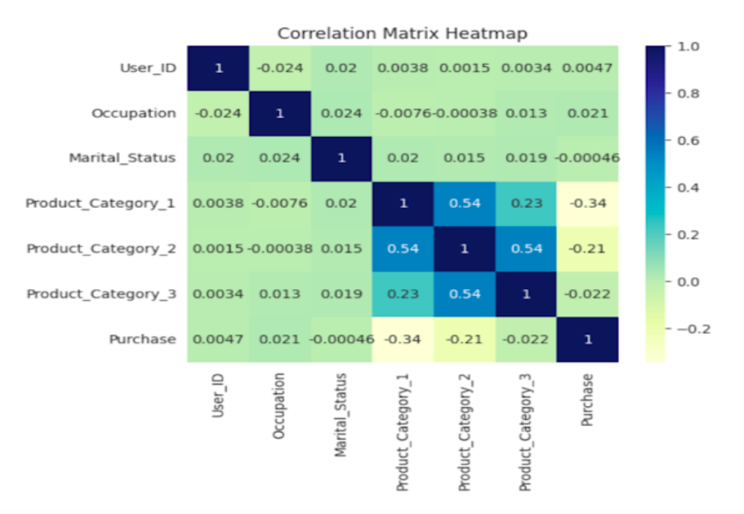
Heatmap - corelation

Slide 20
Clean and Pre-process data
How much data we need?
Data cleaning involves identifying and correcting errors and inconsistencies in the data, such as missing values, duplicates, and incorrect data types.
Notes:
More data is always better to have as long as it does not effect the quality of the data.

Slide 21
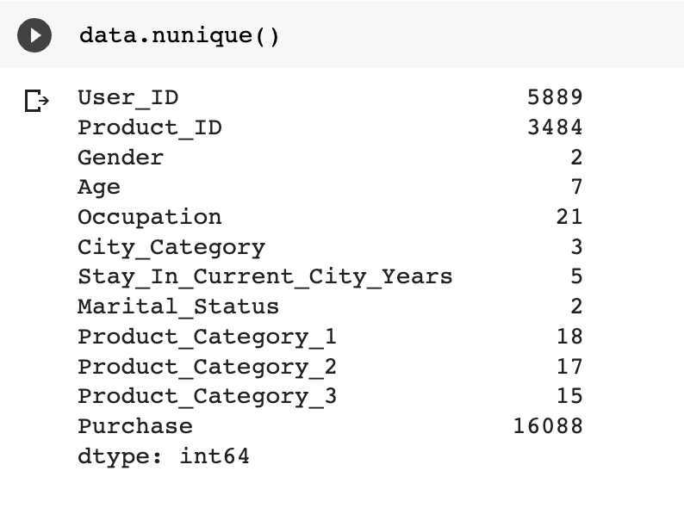
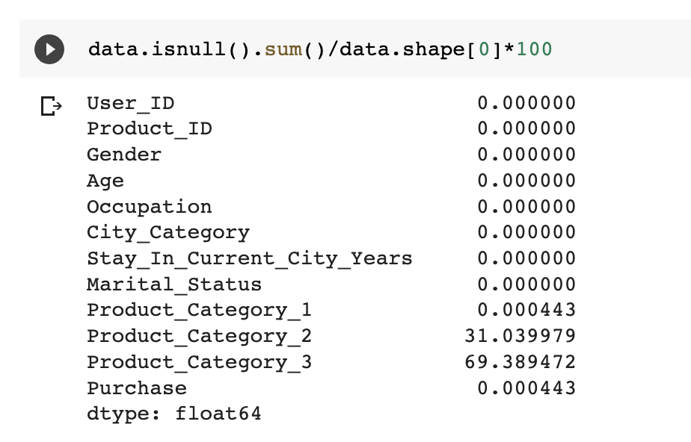
Checking Null values

Slide 22
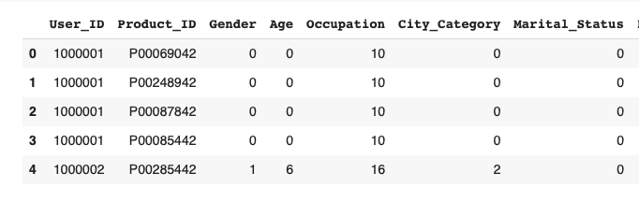
Encoding the Categorical Variables
In order to preprocess the data, we have used Label Encoding to assign a unique numerical label to each category in the variable. To deal with the missing values in columns like Product Category 2 and 3, we have assigned a separate numerical value to indicate the Missing Value.

Slide 23

Dropping the irrelevant columns
Next, we have analyzed all the columns from the dataset and then removed columns such as User_ID and Product_ID before training the model as they are unique values and do not contribute toward achieving performance.

Slide 24
Splitting data into independent and dependent variables
We have 'Purchase' variable as the target variable. This variable will try to predict the number of purchases made by the customer.
So, we split it from the rest of the columns in the data frame.
Now we can start training the model

Slide 25

Training the Model
We have decided to use the following Algorithms and compare them using the Root Mean Squared Error (RMSE) Value:
Linear regression
Decision Tree Regressor
Random Forest Regressor
XGBoost Regression

Slide 26
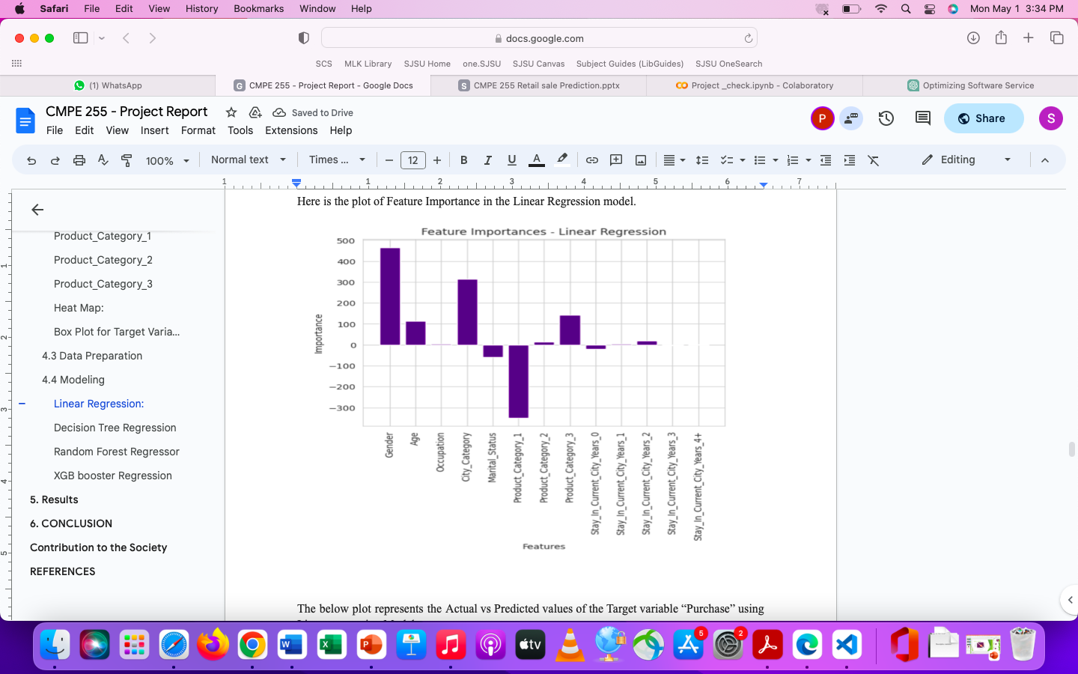
Linear Regression

Slide 27
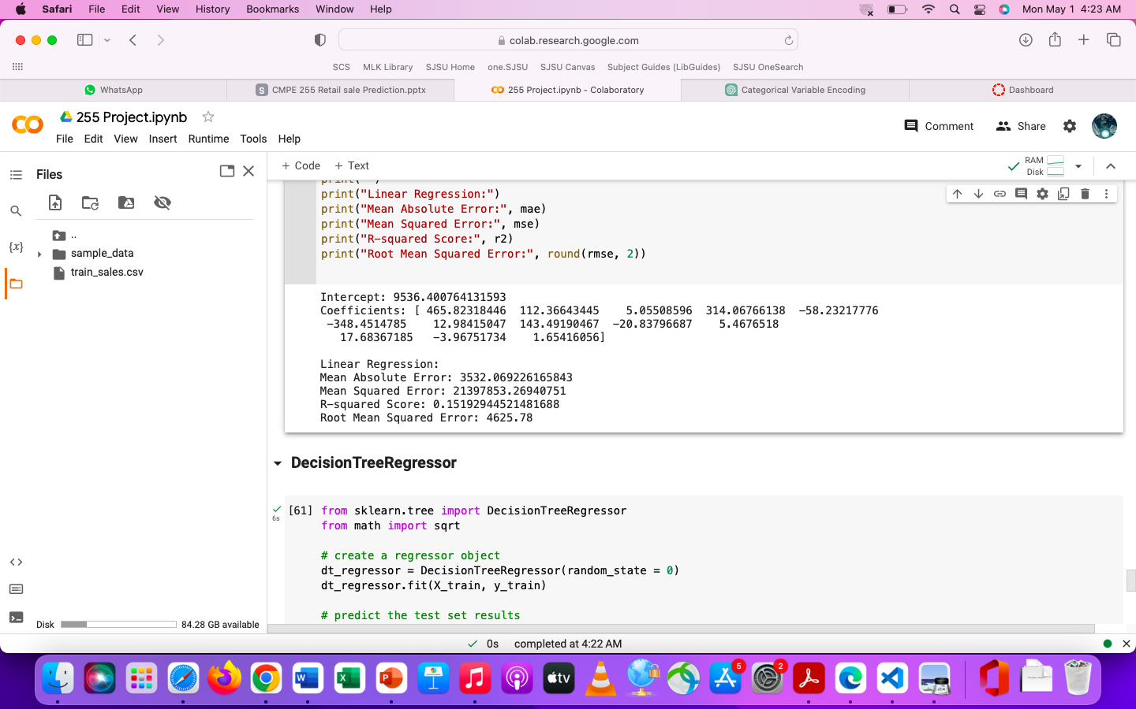
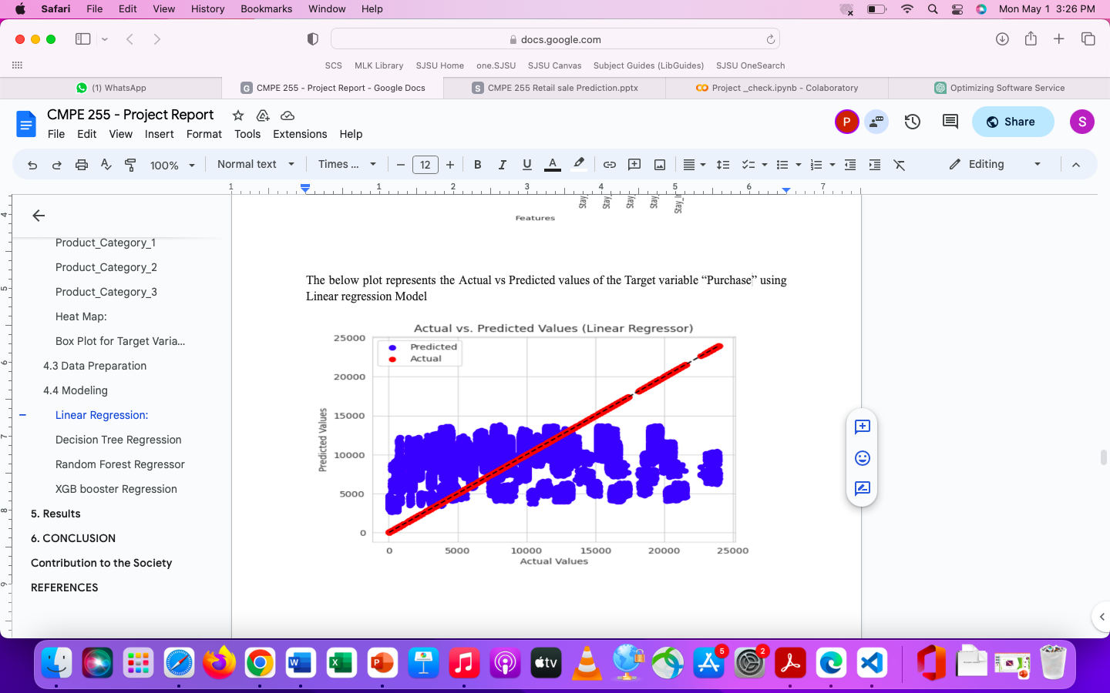
Linear Regression

Slide 28
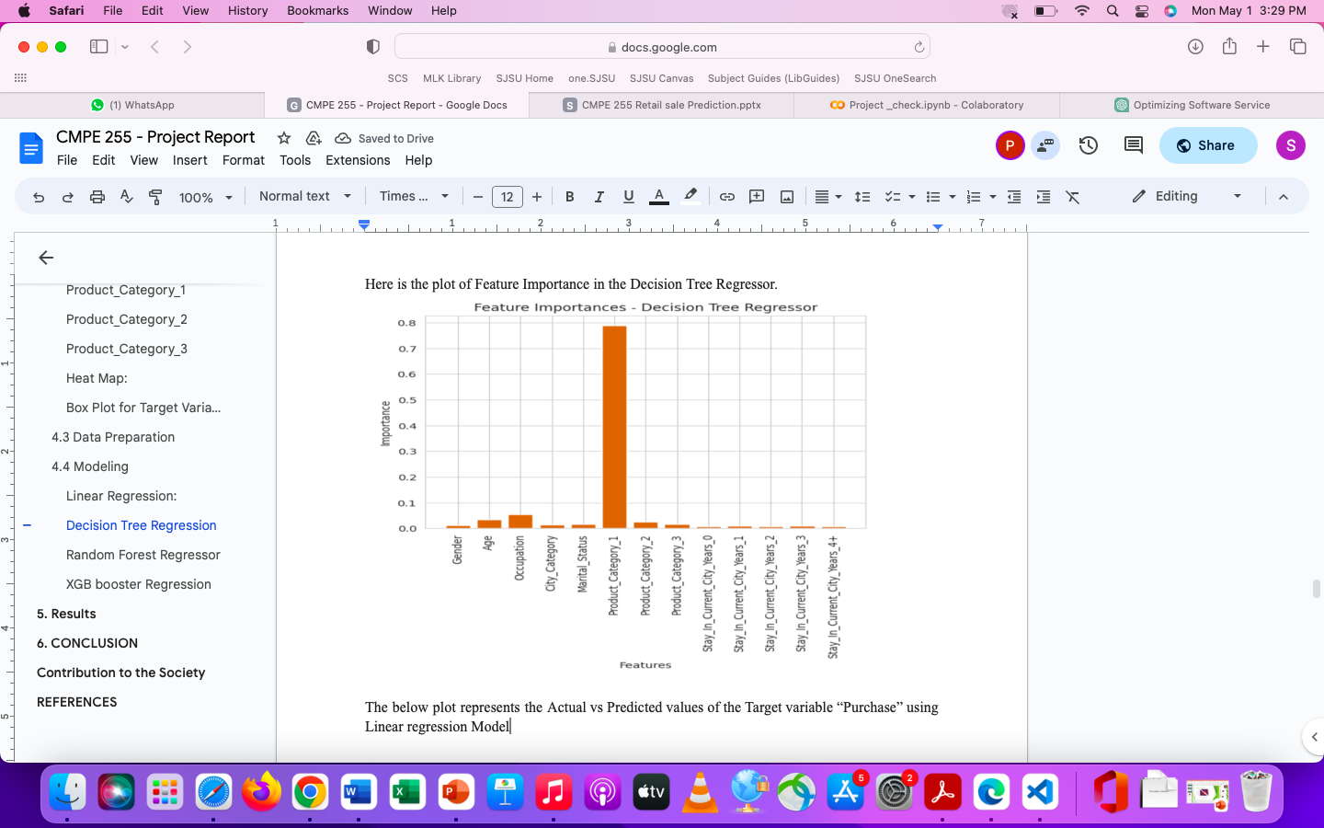
2. Decision Tree Regressor

Slide 29
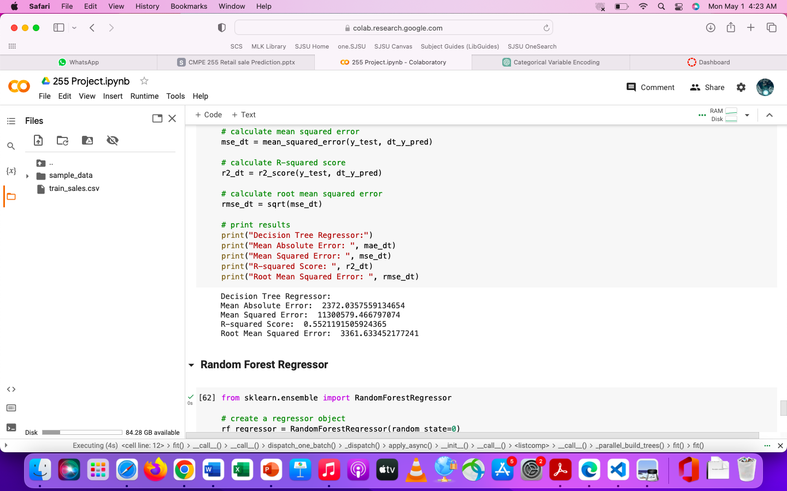
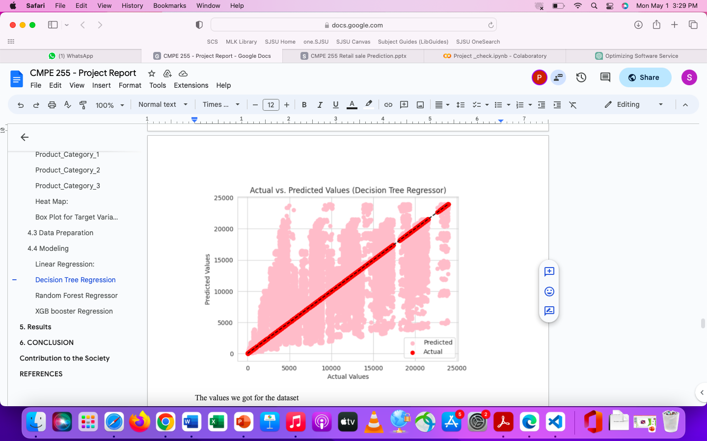
2. Decision Tree Regressor

Slide 30
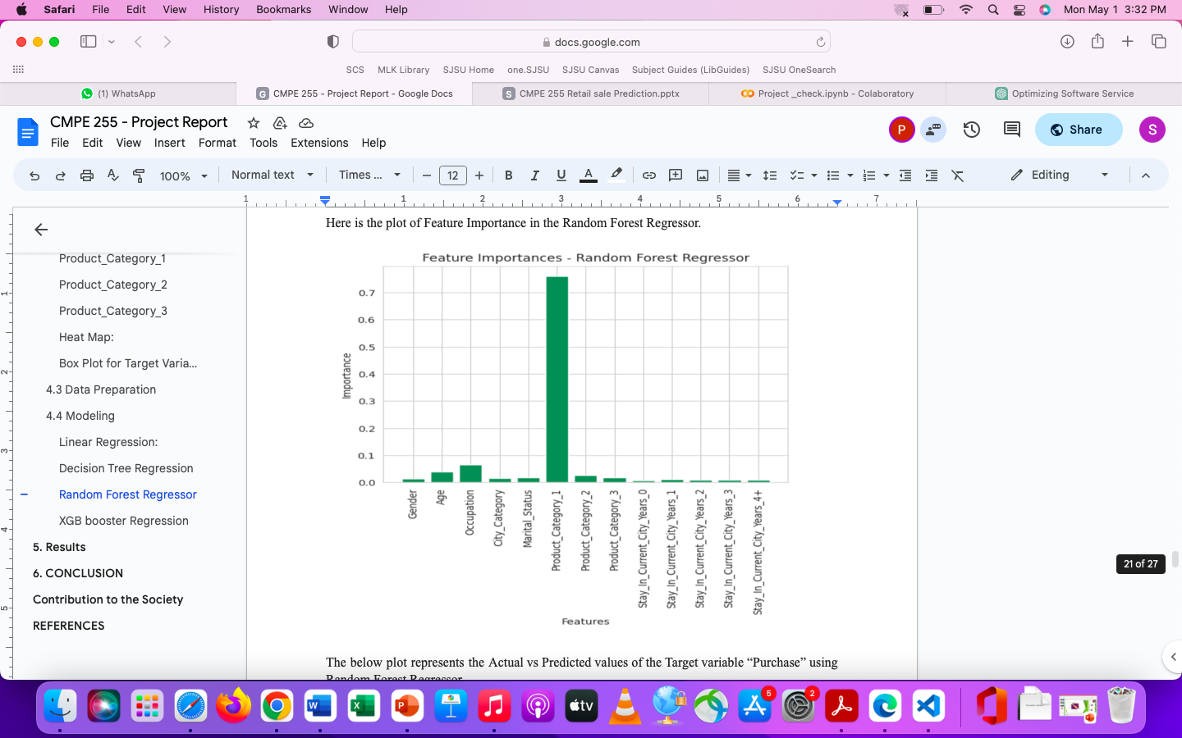
3. Random Forest Regressor

Slide 31
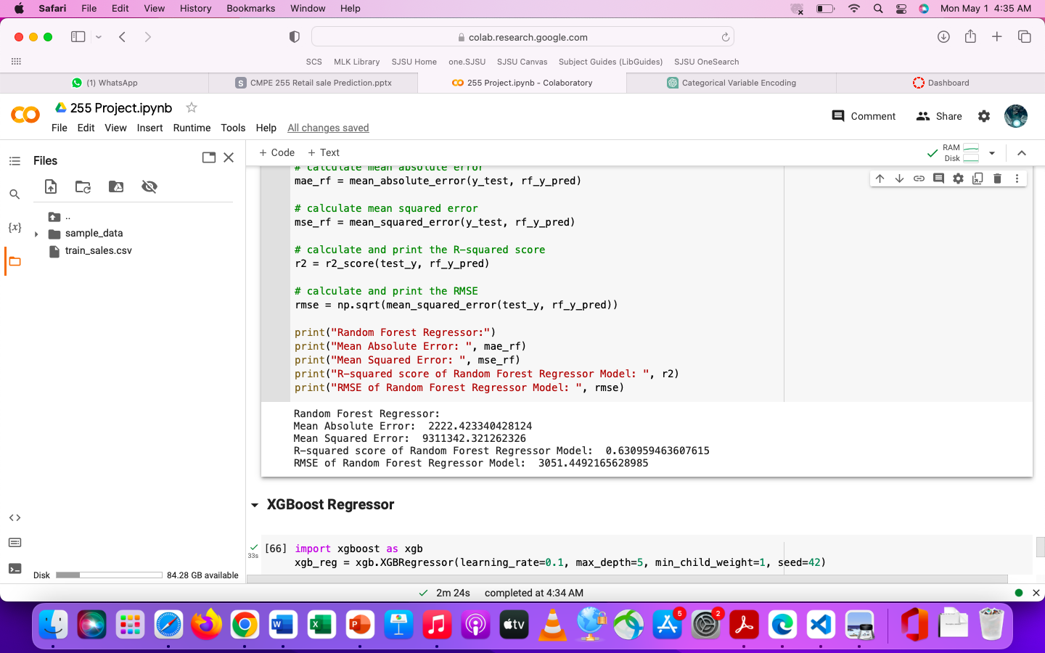
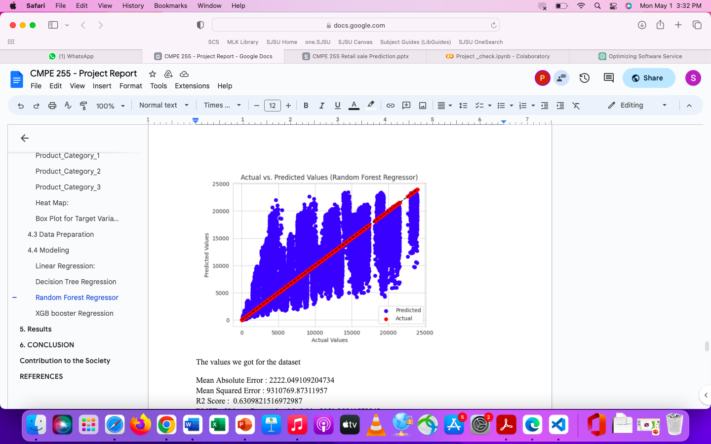
3. Random Forest Regressor

Slide 32
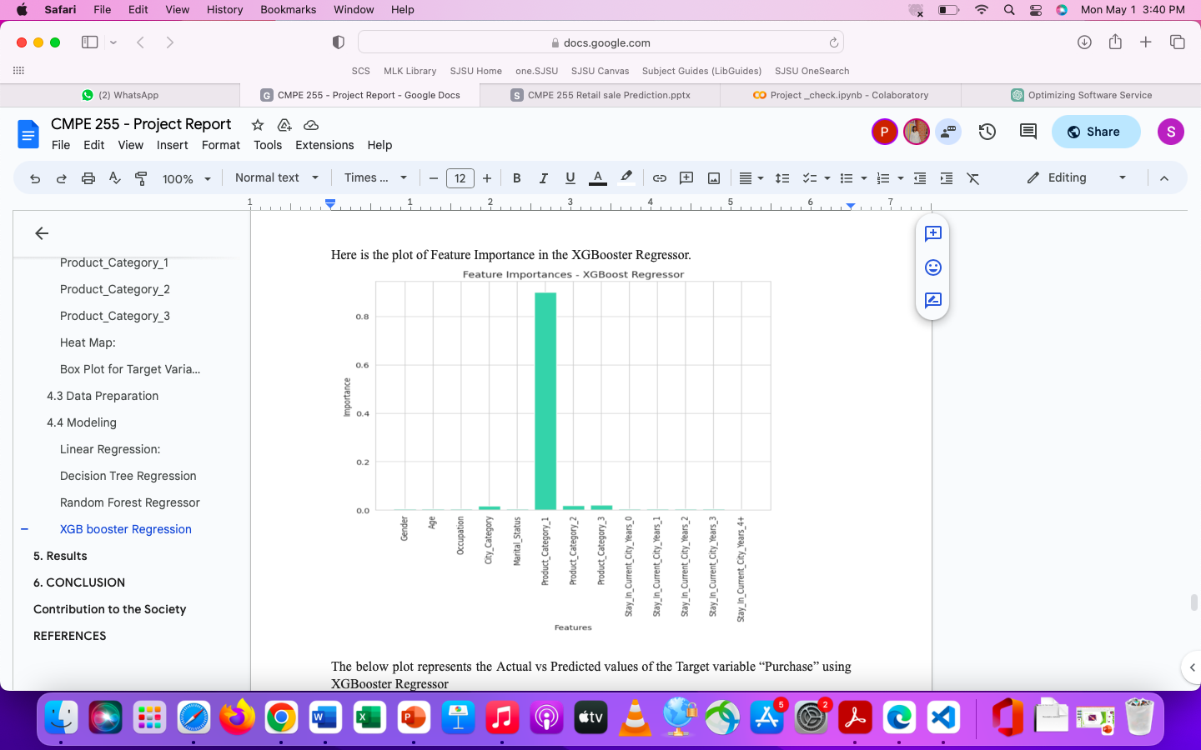
4. XGBoost Regressor

Slide 33
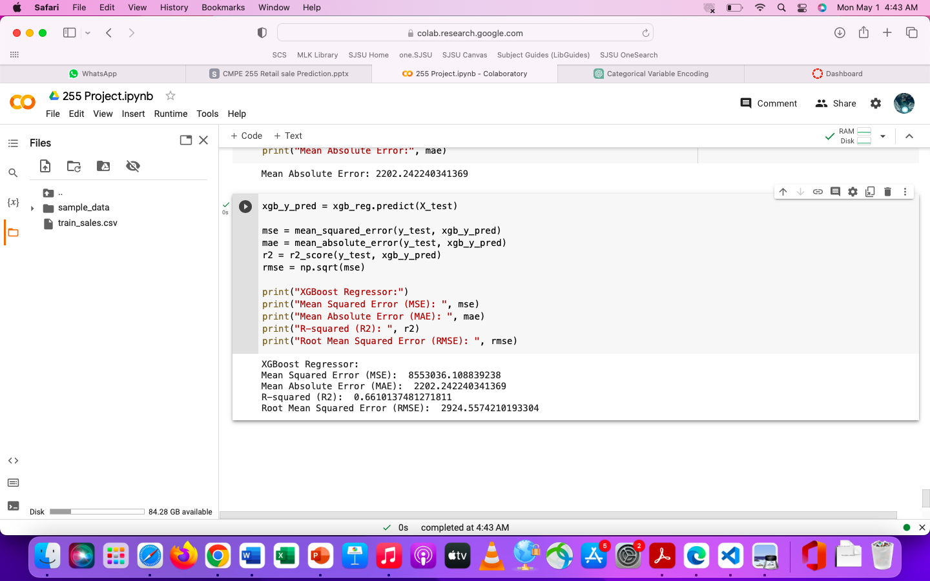
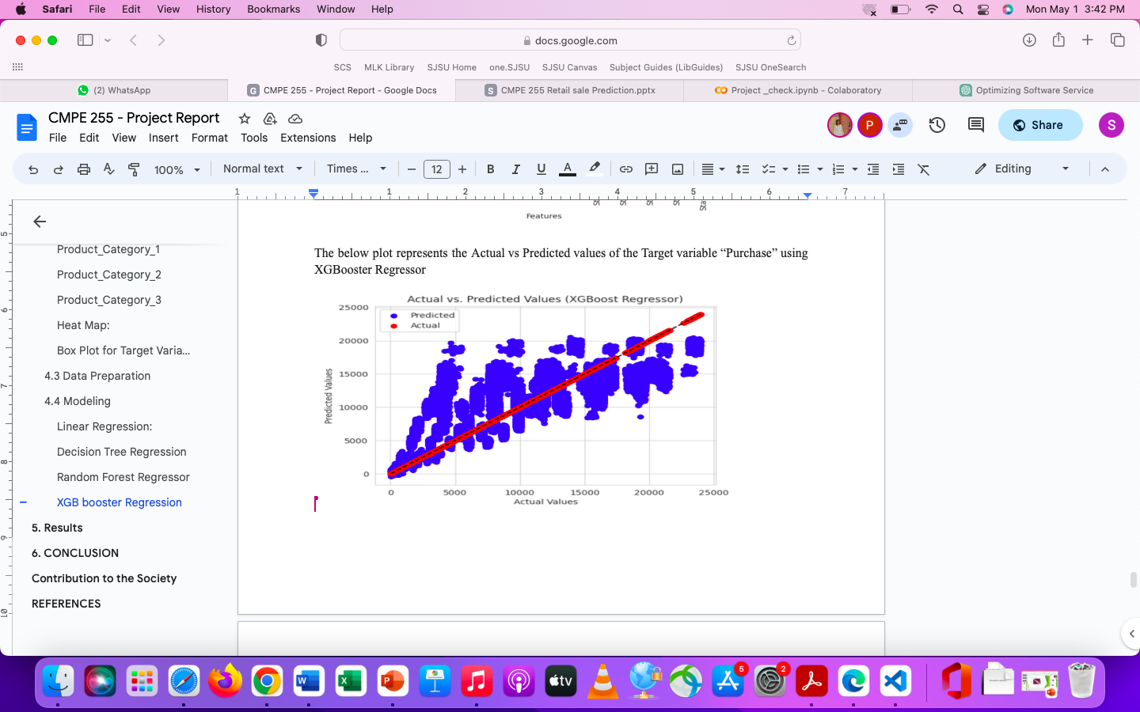
4. XGBoost Regressor

Slide 34
Comparative Analysis:
Model | RMSE
Linear Regression | 4625.78
Decision Tree Regressor | 3361.63
Random Forest Regressor | 3051.44
XGBoost Regressor | 2924.55
From the values, we can conclude the XGBoost Regressor is more suitable for prediction

Slide 35
Conclusion
With traditional techniques not providing much assistance to business growth in terms of income, the implementation of Machine learning methods could prove to be effective in bringing profit to both customers and business.
Sales analysis is based on various factors which enables firms to devise appropriate tactics to boost the sales of high-demand products.
After employing several models including Linear regression, Decision Tree Regressor, Random Forest Regressor, and XGBoost Regressor and assessing their performance utilizing the Root Mean Squared Error (RMSE), we recommend XGBoost Regressor as the most suitable algorithm for predicting sales on the given dataset.
The proposed algorithm will forecast customer purchases on Black Friday and provide retailers with information about customer product preferences. This will result in a discount being offered based on client preferences, ultimately leading to increased profit for both the parties.

Slide 36

Thank you

